Slide 1
Comprehensive Digital Marketing Project Work On Noise
Team Details
K J JOSEPH JERIN (TEAM LEADER)
B JOSITH NAVEEN (TEAM MEMBER)
SANA TEJASWI (TEAM MEMBER)
SOMAYAJULA SURNARAYANA (TEAM MEMBER)
KAMMA SAI SREE ANEESHA (TEAM MEMBER)
KOTTANA MADHU (TEAM MEMBER)

Slide 2
Comprehensive Digital Marketing Project Work On Noise
Team Members
Acknowledgement
I am SOMAYAJULA SURNARAYANA , as a Team Member I have done these following Work in this Project.
1. Power Point Presentation
2. Post Creation
3. Designs/ Video Editing

Slide 3

POST CREATION
POST CREATION
https://www.instagram.com/p/C6HLE1pvqXh/?igsh=bWE5eXZyemc2bXVh

Slide 4

Video Editing
Video Editing
https://www.instagram.com/reel/C6IqhxsLd_C/?igsh=Z2hsNzhxdTlvZnM2

Slide 5
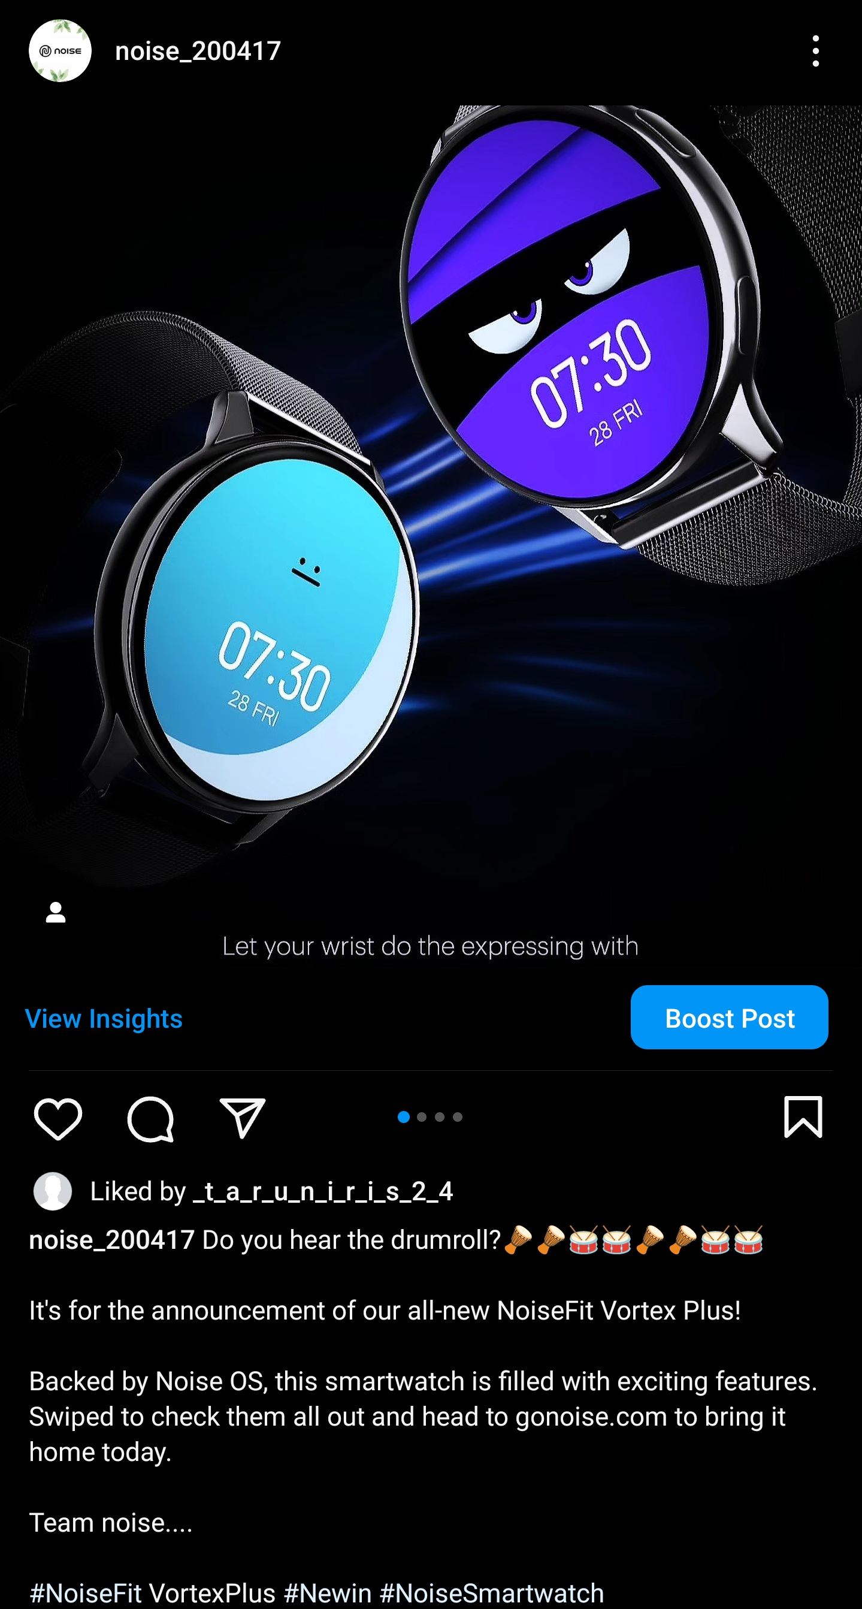
Social media add campaign
Social media add campaign
https://www.instagram.com/p/C6Ixb22LgTc/?igsh=OTVub3drNmtnMjhr

Slide 6
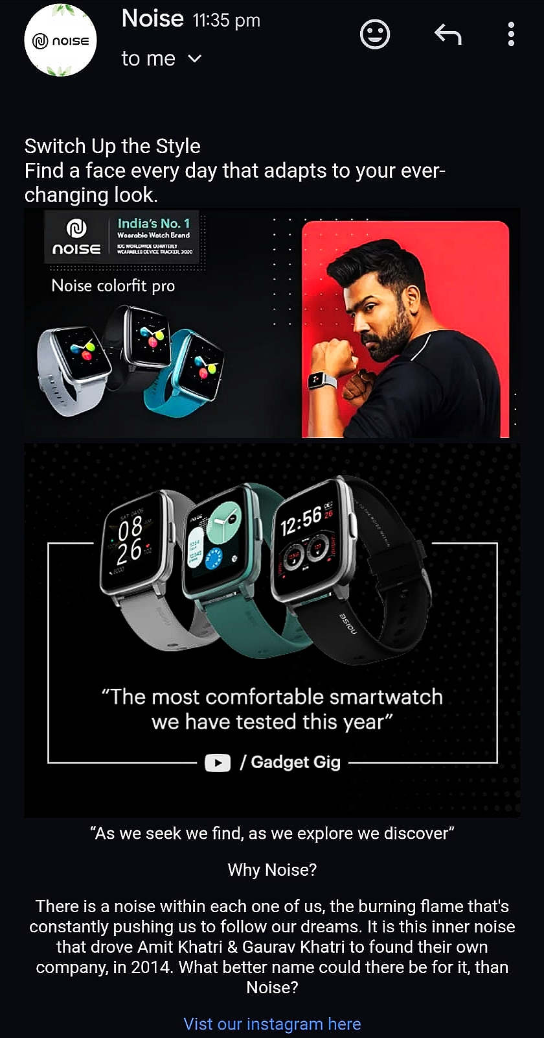
Email add-campaign
Email add-campaign

Slide 7
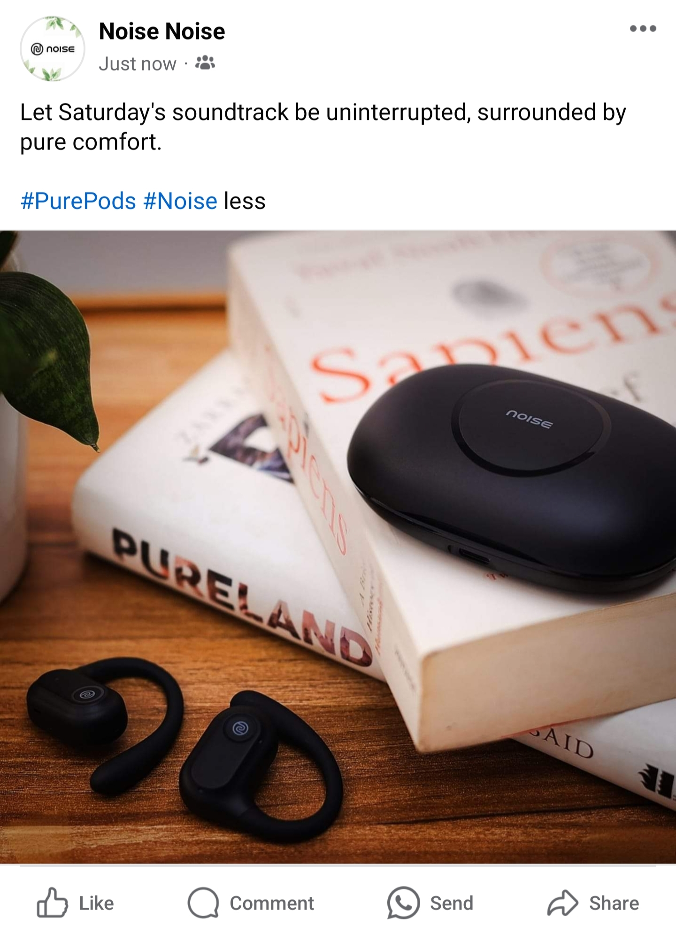
Social media add-campaign
Social media add-campaign
https://www.facebook.com/share/p/cPPA4WnK3LEqFEq7/?mibextid=qi2Omg

Slide 8
Lessons Learned :
Consistency is Key: Consistency in content creation helps to establish brand recognition and build a loyal audience. Maintaining a consistent brand voice, visual identity, and posting schedule creates a cohesive brand experience for the audience.
Quality Over Quantity: While it's important to consistently create content, focusing on quality should take precedence over quantity. Well-produced and thoughtful content tends to have a more significant impact and can lead to higher engagement and brand loyalty.
Building Relationships and Collaborations: Collaboration with influencers, partners, or customers can provide fresh perspectives and expand the reach of the brand's content. Collaborations help tap into new audiences, bring in diverse ideas, and create engaging content.

